Slide 1
Algorithm Analysis
Module 1
Dr. Priyanka N

Slide 2
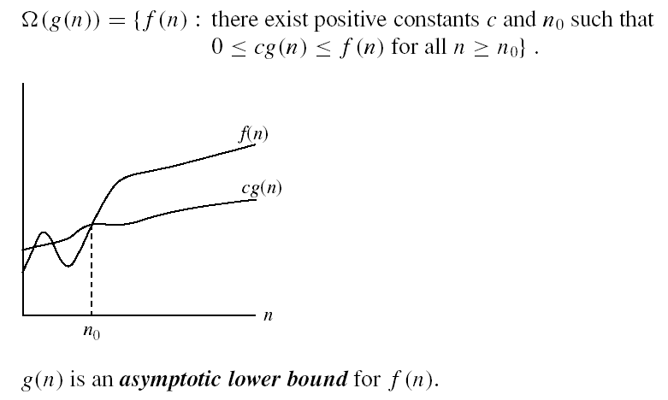
What is f(n)
time taken by the algorithm to execute this is not the real time it is an approximate time
How to find it out f(n)
Two Types of algorithm
Iterative
No of time loop executes
Recursion
Backward Substitution
NOTE: CONSTANT O(1)

Slide 3
Algorithms for computing the Factorial
Recursion
Iterative
int factorial (int n)
{
If (n <= 1)
return 1;
else
return n * factorial(n-1);
}
int factorial (int n)
{ fact =1;
if (n<=1)
return 1;
else {
for (k=2; k<=n; k++)
fact *= k;
return fact;
}
}

Slide 4
Function()
{
int I;
for(i=1 to n)
print(“Hello”);
}
O(n)
Function()
{
int I;
for(i=1 to n)
for(j=1 to n)
print(“Hello”);
}
O(n²)

Slide 5
function(){
int i=1, s=1;
while(S<=n)
{
i++;
s=s+i;
printf(“hello”)
}
}
S
i

Slide 6
function(){
int i=1, s=1;
while(S<=n)
{
i++;
s=s+i;
printf(“hello”)
}
}
S
i 1

Slide 7
function(){
int i=1, s=1;
while(S<=n)
{
i++;
s=s+i;
printf(“hello”)
}
}
S 1
i 1

Slide 8
function(){
int i=1, s=1;
while(S<=n)
{
i++;
s=s+i;
printf(“hello”)
}
}
S 1
i 1 2

Slide 9
function(){
int i=1, s=1;
while(S<=n)
{
i++;
s=s+i;
printf(“hello”)
}
}
S 1 3
i 1 2

Slide 10
function(){
int i=1, s=1;
while(S<=n)
{
i++;
s=s+i;
printf(“hello”)
}
}
S 1 3
i 1 2 3

Slide 11
function(){
int i=1, s=1;
while(S<=n)
{
i++;
s=s+i;
printf(“hello”)
}
}
S 1 3 6
i 1 2 3

Slide 12
function(){
int i=1, s=1;
while(S<=n)
{
i++;
s=s+i;
printf(“hello”)
}
}
S 1 3 6
i 1 2 3 4

Slide 13
function(){
int i=1, s=1;
while(S<=n)
{
i++;
s=s+i;
printf(“hello”)
}
}
S 1 3 6 10
i 1 2 3 4

Slide 14
function(){
int i=1, s=1;
while(S<=n)
{
i++;
s=s+i;
printf(“hello”)
}
}
S 1 3 6 10
i 1 2 3 4 5

Slide 15
function(){
int i=1, s=1;
while(S<=n)
{
i++;
s=s+i;
printf(“hello”)
}
}
S 1 3 6 10 15
i 1 2 3 4 5

Slide 16
function(){
int i=1, s=1;
while(S<=n)
{
i++;
s=s+i;
printf(“hello”)
}
}
S 1 3 6 10 15
i 1 2 3 4 5 6

Slide 17
function(){
int i=1, s=1;
while(S<=n)
{
i++;
s=s+i;
printf(“hello”)
}
}
S 1 3 6 10 15 21
i 1 2 3 4 5 6

Slide 18
function(){
int i=1, s=1;
while(S<=n)
{
i++;
s=s+i;
printf(“hello”)
}
}
S 1 3 6 10 15 21
i 1 2 3 4 5 6.........n

Slide 19
function(){
int i=1, s=1;
while(S<=n)
{
i++;
s=s+i;
printf(“hello”)
}
}
S 1 3 6 10 15 21……n(n+1)/2 n>s stop
i 1 2 3 4 5 6.........n

Slide 20

function(){
int i=1, s=1;
while(S<=n)
{
i++;
s=s+i;
printf(“hello”)
}
}
S 1 3 6 10 15 21……k(k+1)/2
i 1 2 3 4 5 6.........k
K(K+1)/2 >=n
(K²+k)/2>=n
Which means $K^{2}=n$
k =$\sqrt{n}$ ie O($\sqrt{n}$)

Slide 21
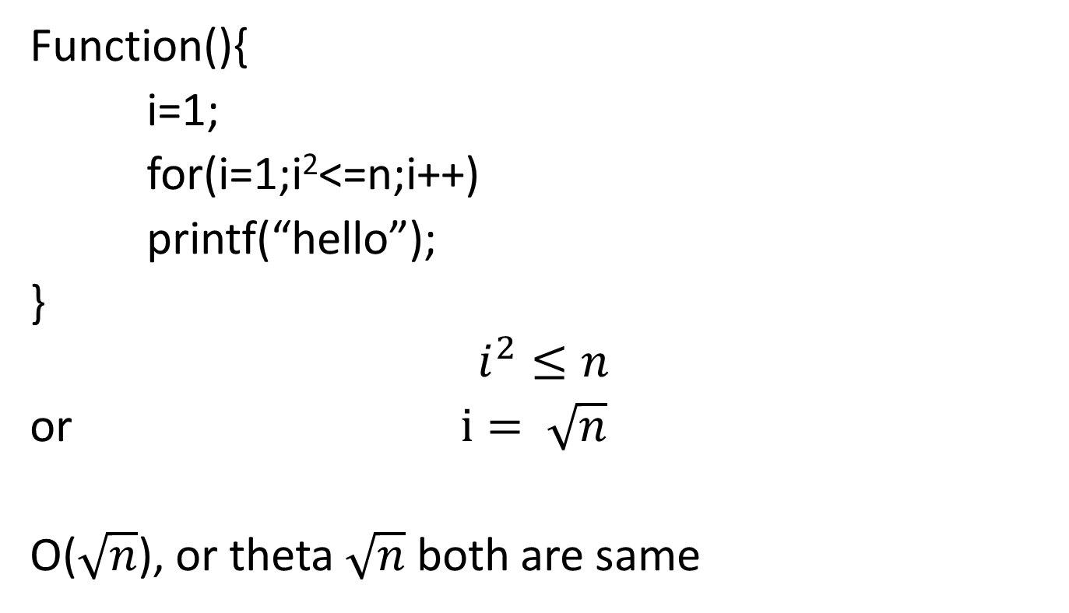
Function(){
i=1;
for(i=1;i²<=n;i++)
printf(“hello”);
}
$$i^{2}≤n$$
or$i= \sqrt{n}$
O($\sqrt{n}$), or theta $\sqrt{n}$ both are same

Slide 22
Function(){
int I,j,k,n;
for(i=1;i<=n;i++){
for(j=1;j<=i;j++){
for(k=1;k<=100;k++){
print(“Hello”);
}
}
}
}
I
J
K

Slide 23
Function(){
int I,j,k,n;
for(i=1;i<=n;i++){
for(j=1;j<=i;j++){
for(k=1;k<=100;k++){
print(“Hello”);
}
}
}
}
I 1
J
K

Slide 24
Function(){
int I,j,k,n;
for(i=1;i<=n;i++){
for(j=1;j<=i;j++){
for(k=1;k<=100;k++){
print(“Hello”);
}
}
}
}
I 1
J 1
K

Slide 25
Function(){
int I,j,k,n;
for(i=1;i<=n;i++){
for(j=1;j<=i;j++){
for(k=1;k<=100;k++){
print(“Hello”);
}
}
}
}
I 1
J 1
K 1*100

Slide 26
Function(){
int I,j,k,n;
for(i=1;i<=n;i++){
for(j=1;j<=i;j++){
for(k=1;k<=100;k++){
print(“Hello”);
}
}
}
}
I 1 2
J 1
K 1*100

Slide 27
Function(){
int I,j,k,n;
for(i=1;i<=n;i++){
for(j=1;j<=i;j++){
for(k=1;k<=100;k++){
print(“Hello”);
}
}
}
}
I 1 2
J 1 2
K 1*100

Slide 28
Function(){
int I,j,k,n;
for(i=1;i<=n;i++){
for(j=1;j<=i;j++){
for(k=1;k<=100;k++){
print(“Hello”);
}
}
}
}
I 1 2
J 1 2
K 1*100 2*100

Slide 29
Function(){
int I,j,k,n;
for(i=1;i<=n;i++){
for(j=1;j<=i;j++){
for(k=1;k<=100;k++){
print(“Hello”);
}
}
}
}
I 1 2 3
J 1 2
K 1*100 2*100

Slide 30
Function(){
int I,j,k,n;
for(i=1;i<=n;i++){
for(j=1;j<=i;j++){
for(k=1;k<=100;k++){
print(“Hello”);
}
}
}
}
I 1 2 3
J 1 2 3
K 1*100 2*100

Slide 31
Function(){
int I,j,k,n;
for(i=1;i<=n;i++){
for(j=1;j<=i;j++){
for(k=1;k<=100;k++){
print(“Hello”);
}
}
}
}
I 1 2 3
J 1 2 3
K 1*100 2*100 3*100

Slide 32
Function(){
int I,j,k,n;
for(i=1;i<=n;i++){
for(j=1;j<=i;j++){
for(k=1;k<=100;k++){
print(“Hello”);
}
}
}
}
I 1 2 3 4
J 1 2 3
K 1*100 2*100 3*100

Slide 33
Function(){
int I,j,k,n;
for(i=1;i<=n;i++){
for(j=1;j<=i;j++){
for(k=1;k<=100;k++){
print(“Hello”);
}
}
}
}
I 1 2 3 4
J 1 2 3 4
K 1*100 2*100 3*100

Slide 34
Function(){
int I,j,k,n;
for(i=1;i<=n;i++){
for(j=1;j<=i;j++){
for(k=1;k<=100;k++){
print(“Hello”);
}
}
}
}
I 1 2 3 4
J 1 2 3 4
K 1*100 2*100 3*100 4*100

Slide 35
Function(){
int I,j,k,n;
for(i=1;i<=n;i++){
for(j=1;j<=i;j++){
for(k=1;k<=100;k++){
print(“Hello”);
}
}
}
}
I 1 2 3 4 5
J 1 2 3 4
K 1*100 2*100 3*100 4*100

Slide 36
Function(){
int I,j,k,n;
for(i=1;i<=n;i++){
for(j=1;j<=i;j++){
for(k=1;k<=100;k++){
print(“Hello”);
}
}
}
}
I 1 2 3 4 5
J 1 2 3 4 5
K 1*100 2*100 3*100 4*100

Slide 37
Function(){
int I,j,k,n;
for(i=1;i<=n;i++){
for(j=1;j<=i;j++){
for(k=1;k<=100;k++){
print(“Hello”);
}
}
}
}
I 1 2 3 4 5
J 1 2 3 4 5
K 1*100 2*100 3*100 4*100 5*100

Slide 38
Function(){
int I,j,k,n;
for(i=1;i<=n;i++){
for(j=1;j<=i;j++){
for(k=1;k<=100;k++){
print(“Hello”);
}
}
}
}
I 1 2 3 4 5…………….n
J 1 2 3 4 5
K 1*100 2*100 3*100 4*100 5*100

Slide 39
Function(){
int I,j,k,n;
for(i=1;i<=n;i++){
for(j=1;j<=i;j++){
for(k=1;k<=100;k++){
print(“Hello”);
}
}
}
}
I 1 2 3 4 5…………….n
J 1 2 3 4 5…………….n
K 1*100 2*100 3*100 4*100 5*100

Slide 40
Function(){
int I,j,k,n;
for(i=1;i<=n;i++){
for(j=1;j<=i;j++){
for(k=1;k<=100;k++){
print(“Hello”);
}
}
}
}
I 1 2 3 4 5…………….n
J 1 2 3 4 5…………….n
K 1*100 2*100 3*100 4*100 5*100…….n*100

Slide 41
Function(){
int I,j,k,n;
for(i=1;i<=n;i++){
for(j=1;j<=i;j++){
for(k=1;k<=100;k++){
print(“Hello”);
}
}
}
}
I 1 2 3 4 5…………….n
J 1 2 3 4 5…………….n
K 1*100 2*100 3*100 4*100 5*100…….n*100
1*100+2*100+3*100+4*100+……n*100

Slide 42
Function(){
int I,j,k,n;
for(i=1;i<=n;i++){
for(j=1;j<=i;j++){
for(k=1;k<=100;k++){
print(“Hello”);
}
}
}
}
I 1 2 3 4 5…………….n
J 1 2 3 4 5…………….n
K 1*100 2*100 3*100 4*100 5*100…….n*100
1*100+2*100+3*100+4*100+……n*100
100(1+2+3+4+……………n)

Slide 43
Function(){
int I,j,k,n;
for(i=1;i<=n;i++){
for(j=1;j<=i;j++){
for(k=1;k<=100;k++){
print(“Hello”);
}
}
}
}
I 1 2 3 4 5…………….n
J 1 2 3 4 5…………….n
K 1*100 2*100 3*100 4*100 5*100…….n
1*100+2*100+3*100+4*100+……n*100
100(1+2+3+4+……………n)
n(n+1)/2 ie O(n²)

Slide 44

Function(){
int I,j,k,n;
for(i=1;i<=n;i++){
for(j=1;j<= $i^{2}$;j++){
for(k=1;k<=n/2;k++){
printf(“Hello”);
}
}
}
}
i
J
K

Slide 45

Function(){
int I,j,k,n;
for(i=1;i<=n;i++){
for(j=1;j<= $i^{2}$;j++){
for(k=1;k<=n/2;k++){
printf(“Hello”);
}
}
}
}
I 1
J
K

Slide 46

Function(){
int I,j,k,n;
for(i=1;i<=n;i++){
for(j=1;j<= $i^{2}$;j++){
for(k=1;k<=n/2;k++){
printf(“Hello”);
}
}
}
}
I 1
J 1
K

Slide 47

Function(){
int I,j,k,n;
for(i=1;i<=n;i++){
for(j=1;j<= $i^{2}$;j++){
for(k=1;k<=n/2;k++){
printf(“Hello”);
}
}
}
}
I 1
J 1
K 1*n/2

Slide 48

Function(){
int I,j,k,n;
for(i=1;i<=n;i++){
for(j=1;j<= $i^{2}$;j++){
for(k=1;k<=n/2;k++){
printf(“Hello”);
}
}
}
}
I 1 2
J 1
K 1*n/2

Slide 49

Function(){
int I,j,k,n;
for(i=1;i<=n;i++){
for(j=1;j<= $i^{2}$;j++){
for(k=1;k<=n/2;k++){
printf(“Hello”);
}
}
}
}
I 1 2
J 1 4
K 1*n/2

Slide 50

Function(){
int I,j,k,n;
for(i=1;i<=n;i++){
for(j=1;j<= $i^{2}$;j++){
for(k=1;k<=n/2;k++){
printf(“Hello”);
}
}
}
}
I 1 2
J 1 4
K 1*n/2 4*n/2

Slide 51

Function(){
int I,j,k,n;
for(i=1;i<=n;i++){
for(j=1;j<= $i^{2}$;j++){
for(k=1;k<=n/2;k++){
printf(“Hello”);
}
}
}
}
I 1 2 3
J 1 4
K 1*n/2 4*n/2

Slide 52

Function(){
int I,j,k,n;
for(i=1;i<=n;i++){
for(j=1;j<= $i^{2}$;j++){
for(k=1;k<=n/2;k++){
printf(“Hello”);
}
}
}
}
I 1 2 3
J 1 4 9
K 1*n/2 4*n/2

Slide 53

Function(){
int I,j,k,n;
for(i=1;i<=n;i++){
for(j=1;j<= $i^{2}$;j++){
for(k=1;k<=n/2;k++){
printf(“Hello”);
}
}
}
}
I 1 2 3
J 1 4 9
K 1*n/2 4*n/2 9*n/2

Slide 54

Function(){
int I,j,k,n;
for(i=1;i<=n;i++){
for(j=1;j<= $i^{2}$;j++){
for(k=1;k<=n/2;k++){
printf(“Hello”);
}
}
}
}
I 1 2 3 4
J 1 4 9
K 1*n/2 4*n/2 9*n/2

Slide 55

Function(){
int I,j,k,n;
for(i=1;i<=n;i++){
for(j=1;j<= $i^{2}$;j++){
for(k=1;k<=n/2;k++){
printf(“Hello”);
}
}
}
}
I 1 2 3 4
J 1 4 9 16
K 1*n/2 4*n/2 9*n/2

Slide 56

Function(){
int I,j,k,n;
for(i=1;i<=n;i++){
for(j=1;j<= $i^{2}$;j++){
for(k=1;k<=n/2;k++){
printf(“Hello”);
}
}
}
}
I 1 2 3 4
J 1 4 9 16
K 1*n/2 4*n/2 9*n/2 16*n/2

Slide 57

Function(){
int I,j,k,n;
for(i=1;i<=n;i++){
for(j=1;j<= $i^{2}$;j++){
for(k=1;k<=n/2;k++){
printf(“Hello”);
}
}
}
}
I 1 2 3 4 5
J 1 4 9 16
K 1*n/2 4*n/2 9*n/2 16*n/2

Slide 58

Function(){
int I,j,k,n;
for(i=1;i<=n;i++){
for(j=1;j<= $i^{2}$;j++){
for(k=1;k<=n/2;k++){
printf(“Hello”);
}
}
}
}
I 1 2 3 4 5
J 1 4 9 16 25
K 1*n/2 4*n/2 9*n/2 16*n/2 25*n/2

Slide 59
Function(){
int I,j,k,n;
for(i=1;i<=n;i++){
for(j=1;j<= $i^{2}$;j++){
for(k=1;k<=n/2;k++){
printf(“Hello”);
}
}
}
}
I 1 2 3 4 5
J 1 4 9 16 25
K 1*n/2 4*n/2 9*n/2 16*n/2 25*n/2

Slide 60

Function(){
int I,j,k,n;
for(i=1;i<=n;i++){
for(j=1;j<= $i^{2}$;j++){
for(k=1;k<=n/2;k++){
printf(“Hello”);
}
}
}
}
I 1 2 3 4 5…………………….n
J 1 4 9 16 25
K 1*n/2 4*n/2 9*n/2 16*n/2 25*n/2

Slide 61

Function(){
int I,j,k,n;
for(i=1;i<=n;i++){
for(j=1;j<= $i^{2}$;j++){
for(k=1;k<=n/2;k++){
printf(“Hello”);
}
}
}
}
I 1 2 3 4 5…………………….n
J 1 4 9 16 25…………………..n2
K 1*n/2 4*n/2 9*n/2 16*n/2 25*n/2

Slide 62
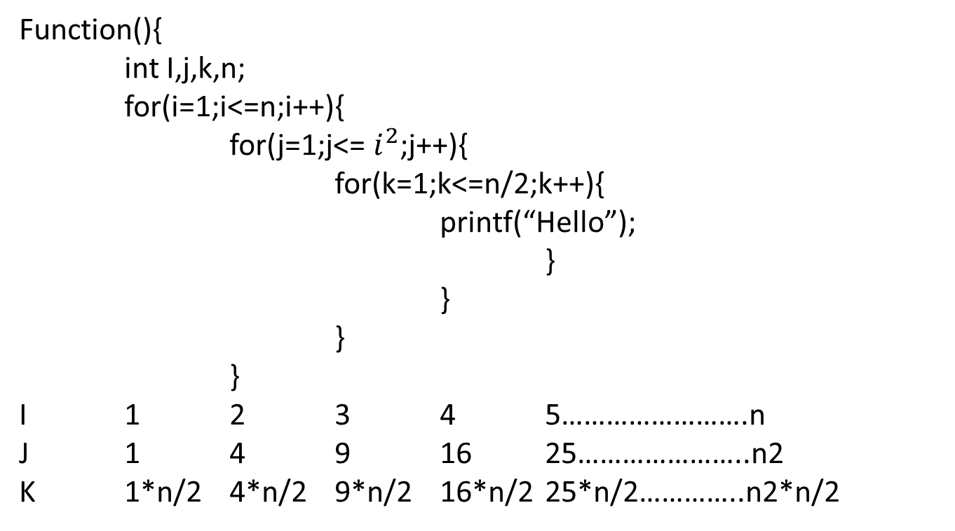
Function(){
int I,j,k,n;
for(i=1;i<=n;i++){
for(j=1;j<= $i^{2}$;j++){
for(k=1;k<=n/2;k++){
printf(“Hello”);
}
}
}
}
I 1 2 3 4 5…………………….n
J 1 4 9 16 25…………………..n2
K 1*n/2 4*n/2 9*n/2 16*n/2 25*n/2…………..n2*n/2

Slide 63

Function(){
int I,j,k,n;
for(i=1;i<=n;i++){
for(j=1;j<= $i^{2}$;j++){
for(k=1;k<=n/2;k++){
printf(“Hello”);
}
}
}
}
I 1 2 3 4 5…………………….n
J 1 4 9 16 25………………….. $n^{2}$
K 1*n/2 4*n/2 9*n/2 16*n/2 25*n/2…………..$n^{2}$*n/2
1*n/2 4*n/2 9*n/2 16*n/2 25*n/2…………..n2*n/2
n/2(1²$+2^{2}+3^{2}$+….. $n^{2}$)
n/2((n(n+1)(2n+1)/6)
O(n⁴)

Slide 64

Function(){
for(i=1;i<n;i=i*2)
printf(“hello”);
}
i=1 2 4 8 16 n
$2^{0}$ $2^{1}$ $2^{2}$ $2^{3}$ $2^{4}$ $2^{k}$
$2^{k}$=n
K=log(n)
O(log₂ n)

Slide 65
Function(){
int i,j,k;
for(i=n/2;i<=n;i++)
for(j=1;j<=n/2;j++)
for(k=1;k<=n;k=k*2)
printf(“hello”);
}

Slide 66
Function(){
int i,j,k;
n/2 for(i=n/2;i<=n;i++)
n/2 for(j=1;j<=n/2;j++)
Log₂ n for(k=1;k<=n;k=k*2)
printf(“hello”);
}
n/2 *n/2*log₂ n
O(n² log₂ n)

Slide 67
Function(){
int I,j,k;
for(i=n/2;i<=n;i++)
for(j=1;j<=n;j=2*j)
for(k=1;k<=n;k=k*2)
printf(“Hello”);
}

Slide 68
Function(){
int I,j,k;
n/2 for(i=n/2;i<=n;i++)
Log₂ n for(j=1;j<=n;j=2*j)
Log₂ n for(k=1;k<=n;k=k*2)
printf(“Hello”);
}
n/2* (Log₂ n)²
O(n* (Log₂ n)²⁾

Slide 69
Function(n){
if(n>1)
return(function(n-1))
}

Slide 70
Function(n){
if(n>1) T(1)
return(function(n-1))
}

Slide 71
Function(n){
if(n>1) T(1)
return(function(n-1)) T(n-1)
}

Slide 72
Function(n){
if(n>1) T(1)
return(function(n-1)) T(n-1)
}
T(n)=1+T(n-1) eq(1)

Slide 73
Function(n){
if(n>1) T(1)
return(function(n-1)) T(n-1)
}
T(n)=1+T(n-1); n>1 eq(1)
T(1) = 1+T(1-1); n=1
T(1) = 1+T(0);
T(1) =1
T(n)=1+T(n-1) eq(1)
To find T(n-1) substitute n-1 to all n in eq(1)

Slide 74
Function(n){
if(n>1) T(1)
return(function(n-1)) T(n-1)
}
T(n)=1+T(n-1) eq(1)
To find T(n-1) substitute n-1 to all n in eq(1)
T(n-1)=1+T(n-2) eq(2)

Slide 75
Function(n){
if(n>1) T(1)
return(function(n-1)) T(n-1)
}
T(n)=1+T(n-1) eq(1)
To find T(n-1) substitute n-1 to all n in eq(1)
T(n-1)=1+T(n-2) eq(2)
To find T(n-2) substitute n-2 to all n in eq(1)

Slide 76
Function(n){
if(n>1) T(1)
return(function(n-1)) T(n-1)
}
T(n)=1+T(n-1) eq(1)
To find T(n-1) substitute n-1 to all n in eq(1)
T(n-1)=1+T(n-2) eq(2)
To find T(n-2) substitute n-2 to all n in eq(1)
T(n-2)=1+T(n-3) eq(3)

Slide 77
Function(n){
if(n>1) T(1)
return(function(n-1)) T(n-1)
}
T(n)=1+T(n-1) eq(1)
To find T(n-1) substitute n-1 to all n in eq(1)
T(n-1)=1+T(n-2) eq(2)
To find T(n-2) substitute n-2 to all n in eq(1)
T(n-2)=1+T(n-3) eq(3)
Backward substitution

Slide 78
Function(n){
if(n>1) T(1)
return(function(n-1)) T(n-1)
}
T(n)=1+T(n-1) eq(1)
To find T(n-1) substitute n-1 to all n in eq(1)
T(n-1)=1+T(n-2) eq(2)
To find T(n-2) substitute n-2 to all n in eq(1)
T(n-2)=1+T(n-3) eq(3)
Backward substitution
Substitute eq(2) in 1 T(n) = I+(1+T(n-2)) = 2+T(n-2)

Slide 79
Function(n){
if(n>1) T(1)
return(function(n-1)) T(n-1)
}
T(n)=1+T(n-1) eq(1)
To find T(n-1) substitute n-1 to all n in eq(1)
T(n-1)=1+T(n-2) eq(2)
To find T(n-2) substitute n-2 to all n in eq(1)
T(n-2)=1+T(n-3) eq(3)
Backward substitution
Substitute eq(2) in 1 T(n) = I+(1+T(n-2)) = 2+T(n-2)
Substitute eq(3) in 2 T(n)=2+(1+T(n-3)) = 3+T(n-3)

Slide 80
Function(n){
if(n>1) T(1)
return(function(n-1)) T(n-1)
}
T(n)=1+T(n-1) eq(1)
To find T(n-1) substitute n-1 to all n in eq(1)
T(n-1)=1+T(n-2) eq(2)
To find T(n-2) substitute n-2 to all n in eq(1)
T(n-2)=1+T(n-3) eq(3)
Backward substitution
Substitute eq(2) in 1 T(n) = I+(1+T(n-2)) = 2+T(n-2)
Substitute eq(3) in 2 T(n)=2+(1+T(n-3)) = 3+T(n-3)
K+T(n-k) eq(4)

Slide 81
Function(n){
if(n>1) T(1)
return(function(n-1)) T(n-1)
}
T(n)=1+T(n-1) eq(1)
To find T(n-1) substitute n-1 to all n in eq(1)
T(n-1)=1+T(n-2) eq(2)
To find T(n-2) substitute n-2 to all n in eq(1)
T(n-2)=1+T(n-3) eq(3)
Backward substitution
Substitute eq(2) in 1 T(n) = I+(1+T(n-2)) = 2+T(n-2)
Substitute eq(3) in 2 T(n)=2+(1+T(n-3)) = 3+T(n-3)
K+T(n-k) eq(4)
When n-k=1 loop stop so k=n-1 substitute in eq(4)

Slide 82
Function(n){
if(n>1) T(1)
return(function(n-1)) T(n-1)
}
T(n)=1+T(n-1) eq(1)
To find T(n-1) substitute n-1 to all n in eq(1)
T(n-1)=1+T(n-2) eq(2)
To find T(n-2) substitute n-2 to all n in eq(1)
T(n-2)=1+T(n-3) eq(3)
Backward substitution
Substitute eq(2) in 1 T(n) = I+(1+T(n-2)) = 2+T(n-2)
Substitute eq(3) in 2 T(n)=2+(1+T(n-3)) = 3+T(n-3)
K+T(n-k)
When n-k=1 loop stop so k=n-1 substitute in eq(4)
n-1+T(n-(n-1)))

Slide 83
Function(n){
if(n>1) T(1)
return(function(n-1)) T(n-1)
}
T(n)=1+T(n-1) eq(1)
To find T(n-1) substitute n-1 to all n in eq(1)
T(n-1)=1+T(n-2) eq(2)
To find T(n-2) substitute n-2 to all n in eq(1)
T(n-2)=1+T(n-3) eq(3)
Backward substitution
Substitute eq(2) in 1 T(n) = I+(1+T(n-2)) = 2+T(n-2)
Substitute eq(3) in 2 T(n)=2+(1+T(n-3)) = 3+T(n-3)
K+T(n-k)
When n-k=1 loop stop so k=n-1 substitute in eq(4)
n-1+T(n-(n-1)))
n

Slide 84
Function(n){
if(n>1) T(1)
return(function(n-1)) T(n-1)
}
T(n)=1+T(n-1) eq(1)
To find T(n-1) substitute n-1 to all n in eq(1)
T(n-1)=1+T(n-2) eq(2)
To find T(n-2) substitute n-2 to all n in eq(1)
T(n-2)=1+T(n-3) eq(3)
Backward substitution
Substitute eq(2) in 1 T(n) = I+(1+T(n-2)) = 2+T(n-2)
Substitute eq(3) in 2 T(n)=2+(1+T(n-3)) = 3+T(n-3)
K+T(n-k)
When n-k=1 loop stop so k=n-1 substitute in eq(4)
n-1+T(n-(n-1)))
n
O(n)

Slide 85
T(n)=n+T(n-1) n>1
T(1)=1+T(1-1) n=1
T(n)=n+T(n-1) eq(1)
To find T(n-1) substitute n-1 to all n in eq(1)
T(n-1)=n-1+T(n-2) eq(2)
To find T(n-2) substitute n-2 to all n in eq(1)
T(n-2)=n-2+T(n-3) eq(3)
Backward substitution
T(n) = n+T(n-1)
Substitute eq(2) in 1 T(n) = n+(n-1)+T(n-2)
Substitute eq(3) in 2 T(n)=n+(n-1)+(n-2)+T(n-3)) ….+(n-k)+T(n-(k+1)) eq(4)
1
When n-(k+1)=1 loop stop so k=n-2 substitute in eq(4)
n-(K+1)) =1
n-k-1=1
K=n-2
T(1)
T(n)= n+(n-1)+(n-2)+T(n-3)) ….+(n- (n-2))+T(n-((n-2)+1)
= n+(n-1)+(n-2)+T(n-3)) ….+2 +1
= n(n+1)/2
= O(n²)

Slide 86
Recursion Tree Method
The recursion tree method is a way of solving recurrence relations
In this method, a recurrence relation is converted into recursive trees
Each node represents the cost incurred at various levels of recursion
To find the total cost, costs of all levels are summed up

Slide 87
Example 1
T(n) = 2T(n/2)+C ; n>1
= C ; n=1
if I do C amount of work, I could produce 2 problems with smaller sets of inputs and each input size is reduced to n/2.
T(n) ------- C
T(n/2) T(n/2)

Slide 88
T(n) = 2T(n/2)+C ; n>1 t(n/2)=2t(n/4)+c
= C ; n=1 t(n/4)=2t(n/8)+c
T(n) ------- C
T(n/2) T(n/2)
C
C T(n/2) similarly
T(n/4) T(n/4)

Slide 89
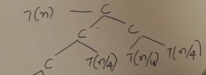
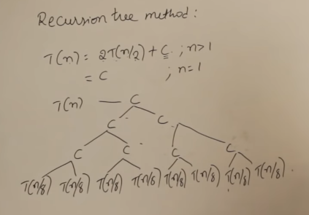

Slide 90
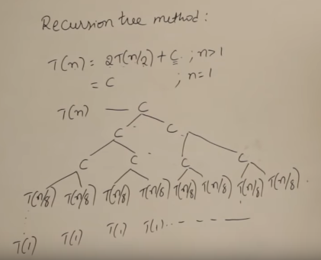
C 1C
2C
4C
8C
T(n/n)……….. T(n/n) nC
T(1) = T(n/n)
C+2C+4C+…NC
C(1+2+4+…..n) assume n=2^{k} (for simiplication)
C(1+2+4+….. 2^{k}) => c(1(2^{k+1} -1)) / (2-1) [G.P a(r^{n+1} -1)/(r-1)]
=> C(2^{k+1} -1)
=>C(2^{k} .2¹ -1)
=> C(2n-1)
=> O(n)

Slide 91
Example 2
T(n) = 2T(n/2)+n² ; n>1
= 1 ; n=1

